Slide 1
Word Embedding Explained
and Visualized
Xin Rong
School of Information
University of Michigan

Slide 2
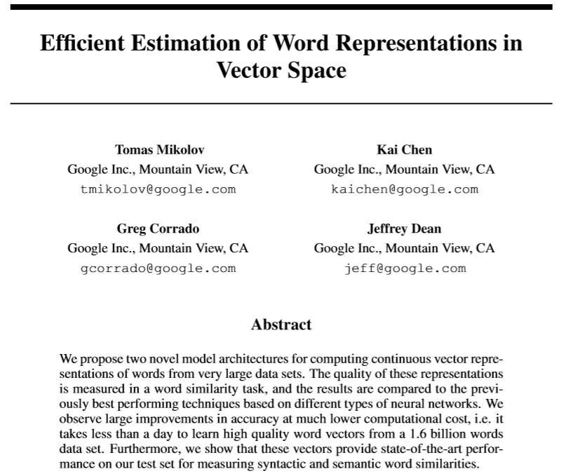
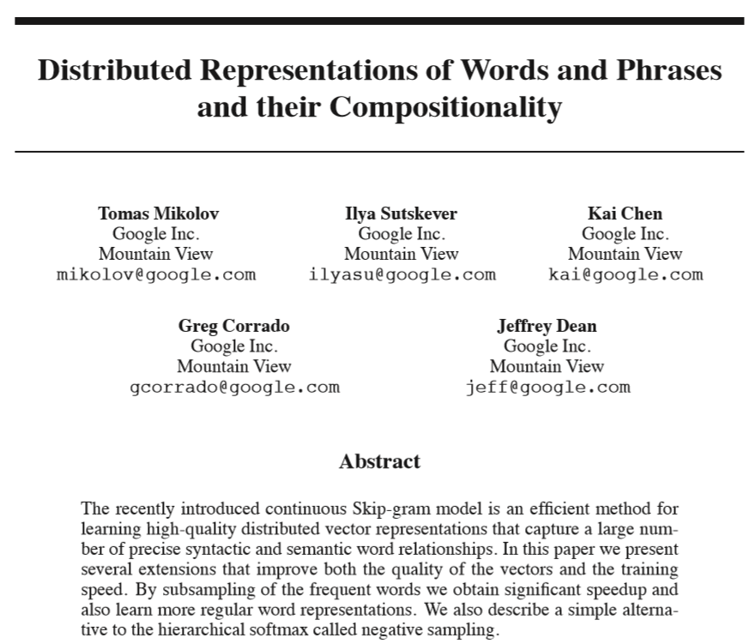
About word2vec...
Two original papers published in association with word2vec by Mikolov et al. (2013)

Slide 3
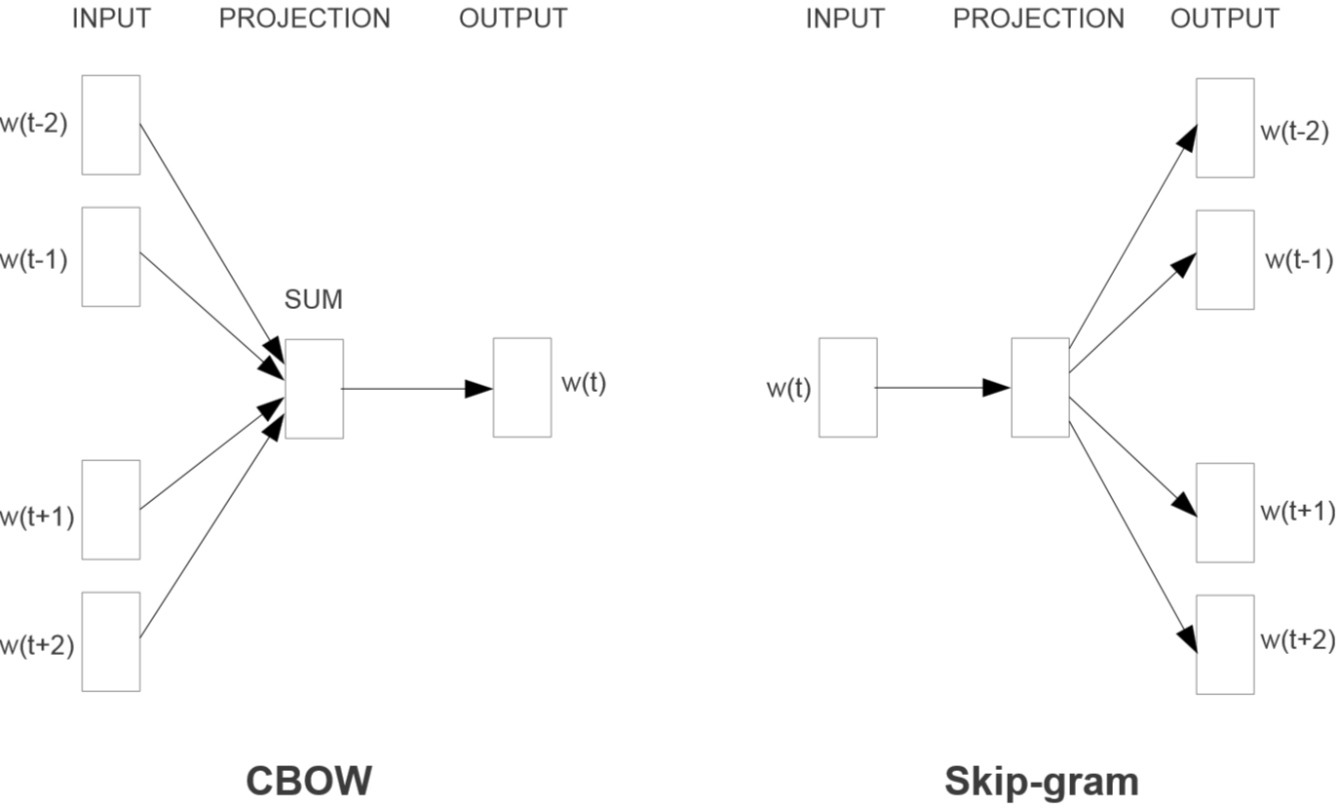

Slide 4
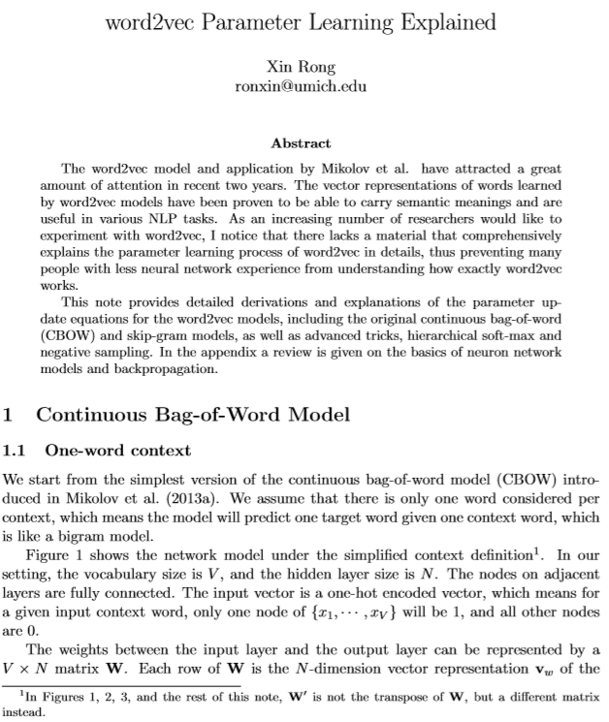
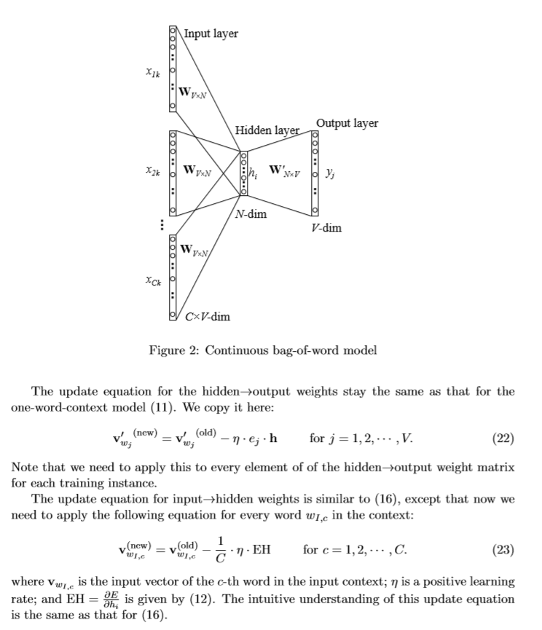

Slide 5
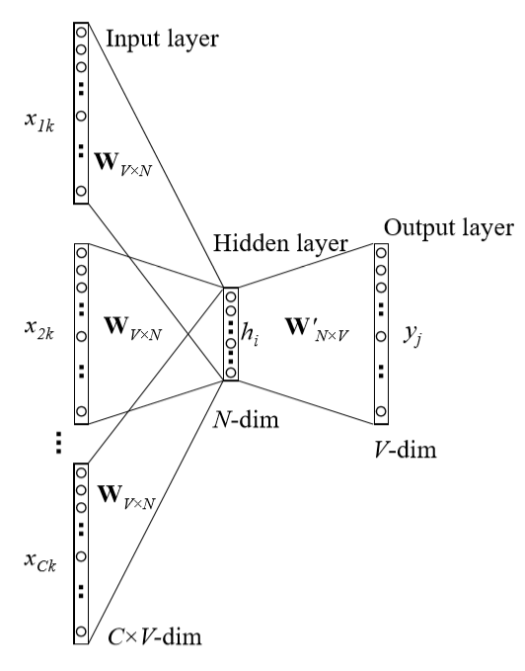
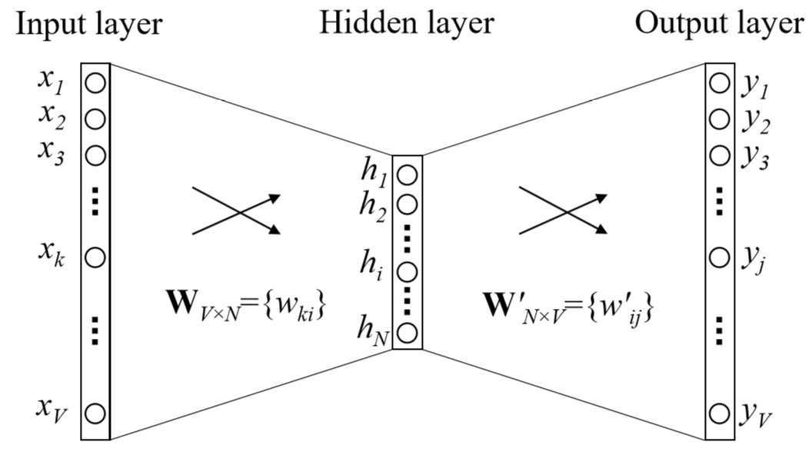
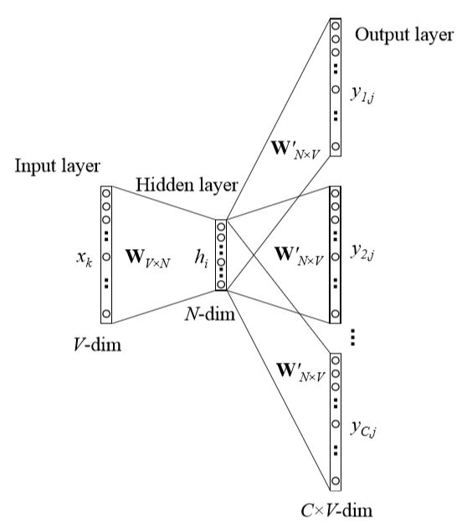
CBOW
word2vec model architecture
Skip-gram

Slide 6
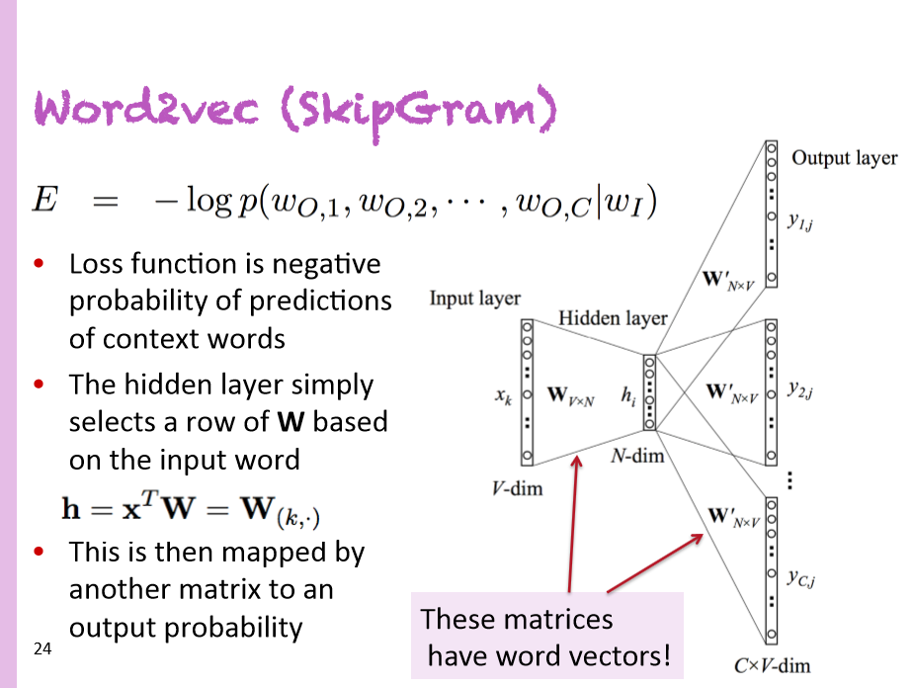
Christopher Manning
Deep Learning Summer School (2015)

Slide 7
Atomic Word Representation
Word is represented by identity
apple
[0 0 0 0 0 1 0 0 0 0 0 0 0 0 0 0 0 0 ... 0 0 0 0 0 0]
orange
[0 0 0 0 0 0 0 0 0 0 0 0 0 1 0 0 0 0 ... 0 0 0 0 0 0]
car
[0 0 0 0 0 0 0 1 0 0 0 0 0 0 0 0 0 0 ... 0 0 0 0 0 0]
apple juice
_____ juice
?

Slide 8

Distributed Representation
Word is represented as continuous level of activations
apple
orange
car
inhibited
excited

Slide 9
Contextual Representation
Word is represented by context in use
I eat an apple every day.
I eat an orange every day.
I like driving my car to work.

Slide 10
Word Vectors
juice
apple
orange
banana
rice
milk
bus
car
train

Slide 11
Word Analogy
king
queen
uncle
aunt
man
woman
Mikolov & Chen et al. 2013
Mikolov & Sutskever et al. 2013

Slide 12
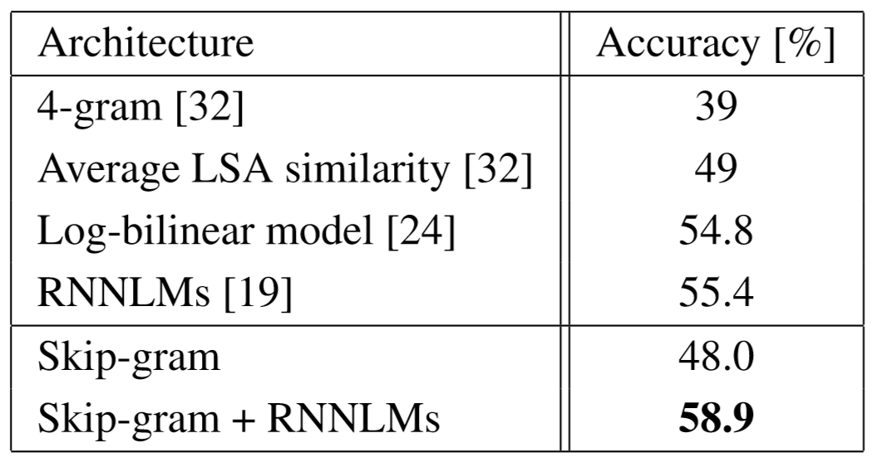
Applications benefited by word embeddings
Dependency parsing
Named entity recognition
Document classification
Sentiment Analysis
Paraphrase Detection
Word Clustering
Machine Translation
Table 7: Comparison and combination of models on the Microsoft Sentence Completion Challenge
"Efficient estimation of word representations in vector space" Mikolov & Chen et al. 2013

Slide 13

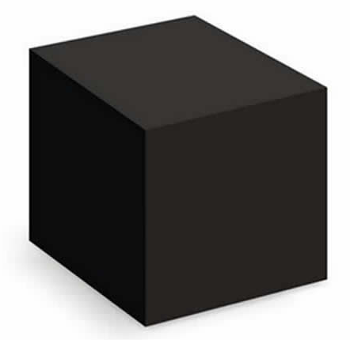
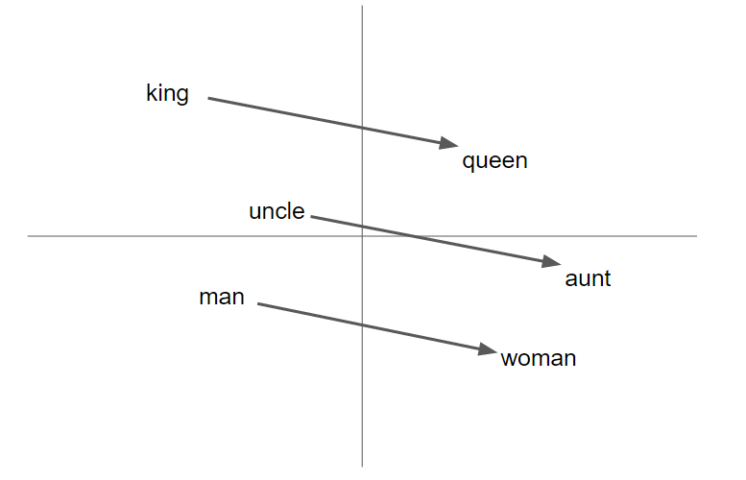
word2vec as a (powerful) black box
word2vec
Wikipedia

Slide 14
word2vec decomposed
Input Corpus
Vocabulary
Builder
Lossy Counting
Vocabulary
Sentence Windows
Context Builder
Dynamic Window Scaling
Subsampling
Pruning
CBOW
Skip-gram
Input
Words
Output
Words
Vectors
(Final Product)
Parameter Learner
Backpropagation
Hierarchical Softmax
Negative Sampling

Slide 15
wevi
demo
bit.ly/wevi-online

Slide 16
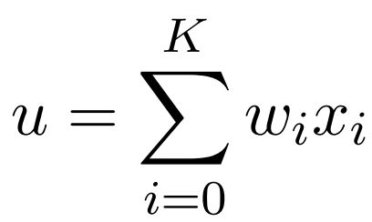
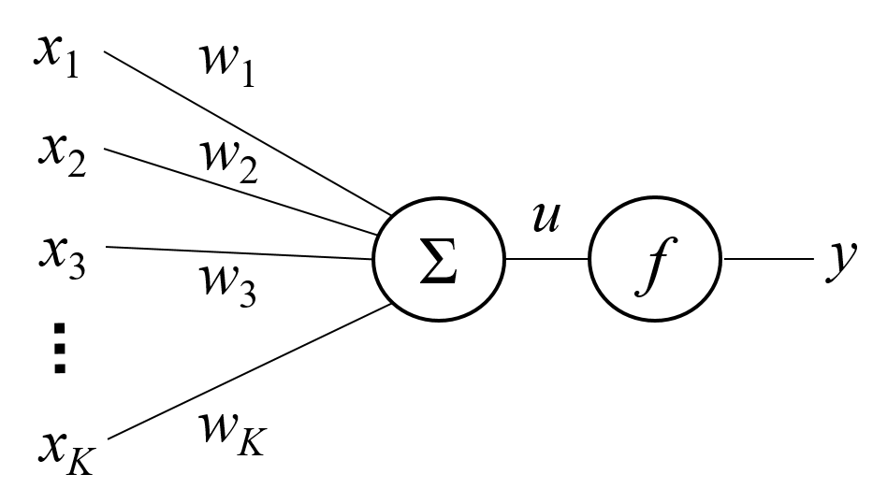
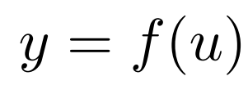
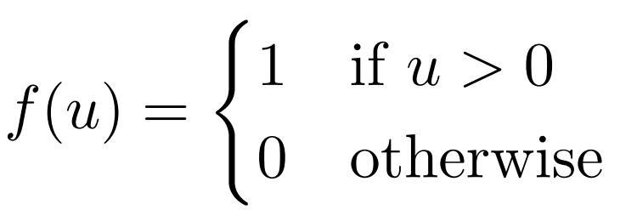
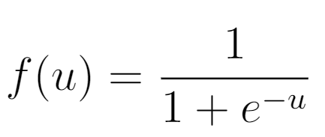
Basic Neuron Structure
a neuron

Slide 17
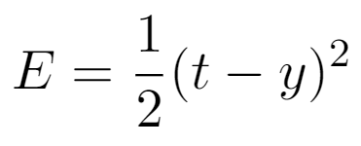
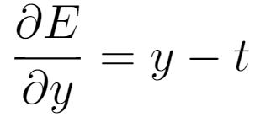
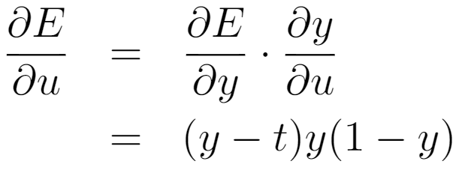
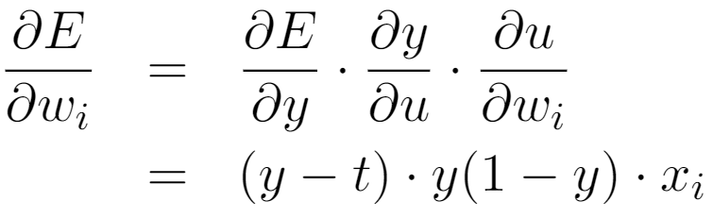
Training a Single Neuron
x
t
a neuron

Slide 18
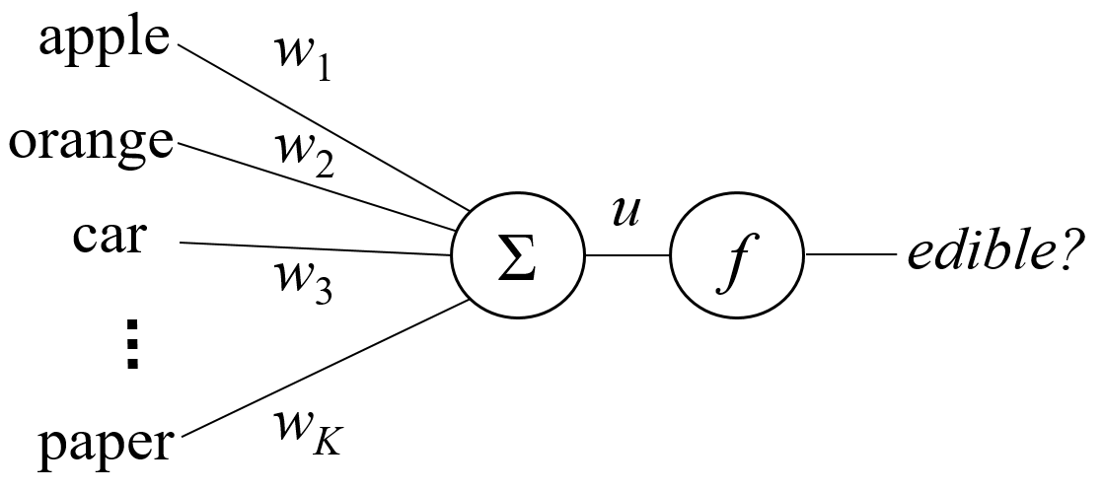
Task Afforded by a Single Neuron
A lookup table
Item | Edible?
apple | Y
orange | Y
car | N
... | ...
paper | N

Slide 19
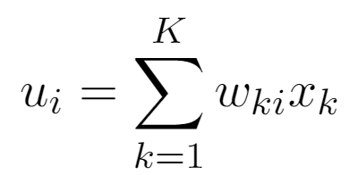
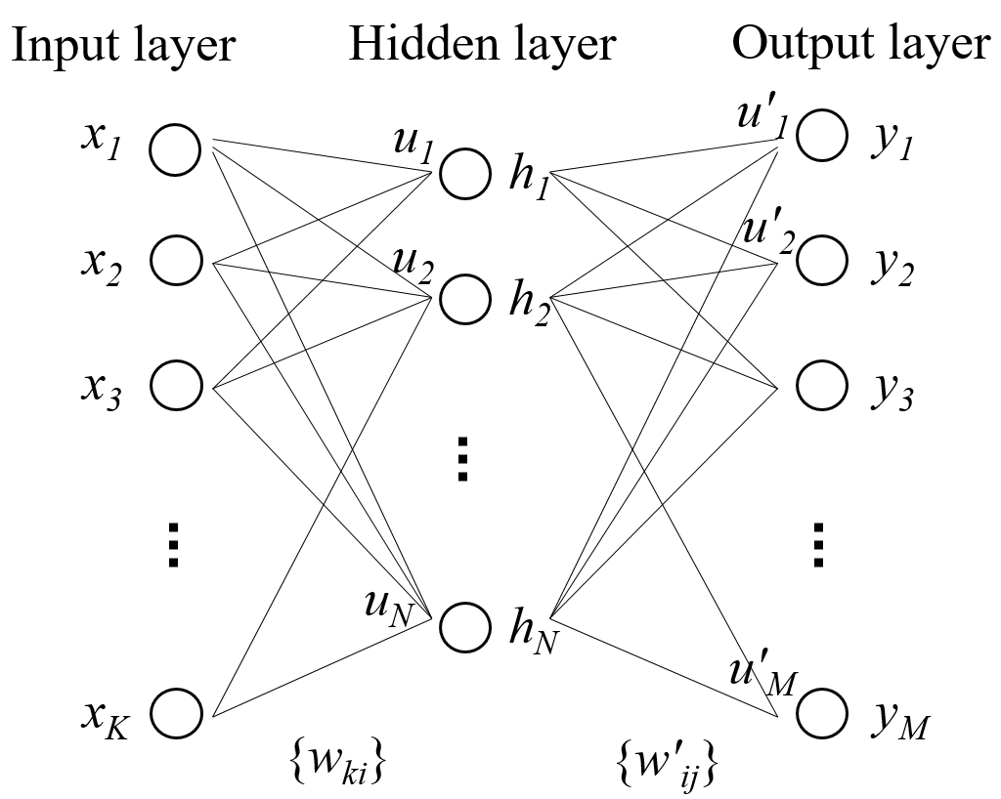
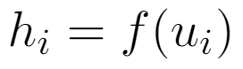
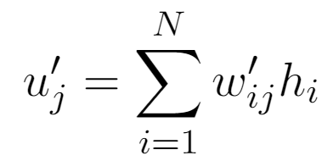
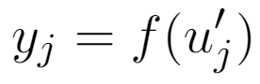
Multilayer Neural Network

Slide 20
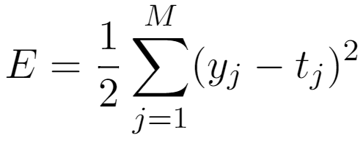
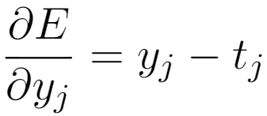
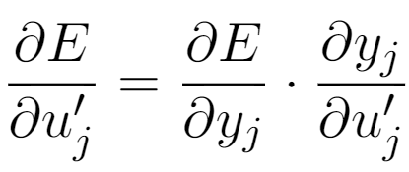
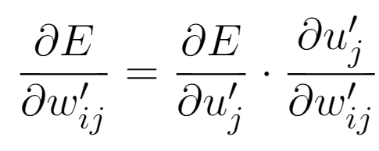
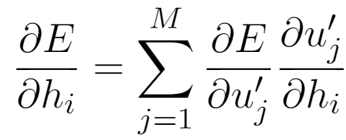
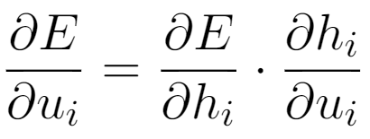
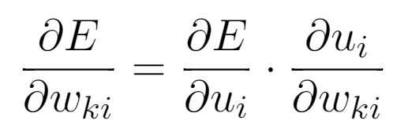
Backpropagation
x
t

Slide 21
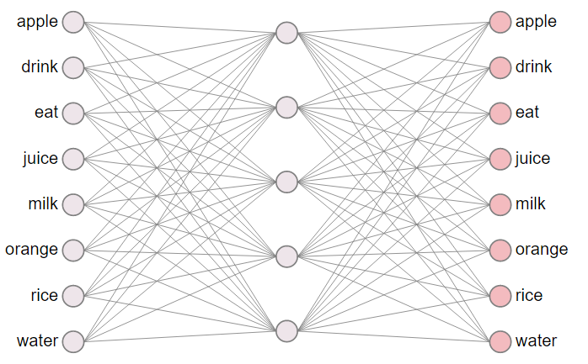
word2vec network
Structure Highlights:
input layer
one-hot vector
hidden layer
linear (identity)
output layer
softmax

Slide 22
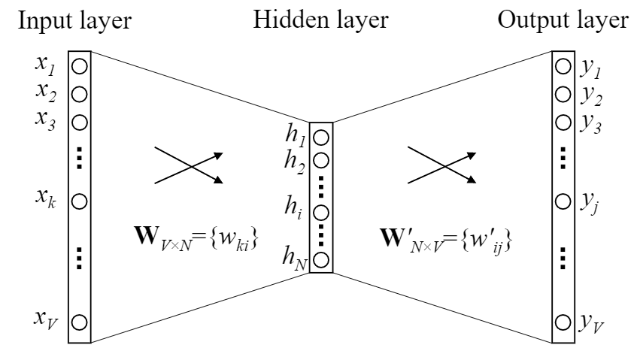
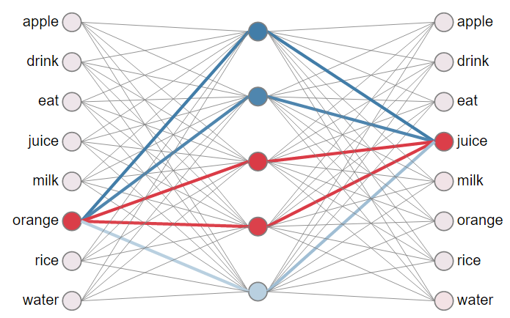
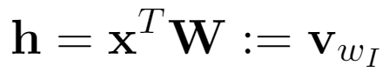
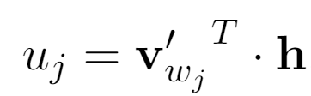
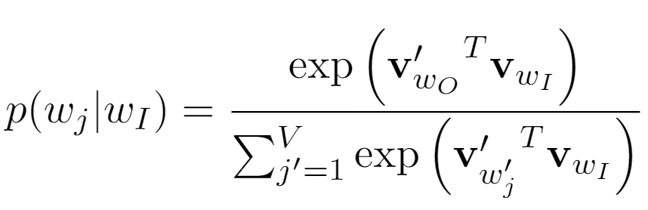
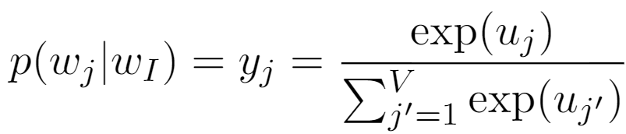
word2vec network

Slide 23
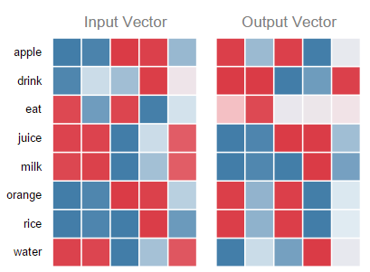
neural network and weight matrices

Slide 24
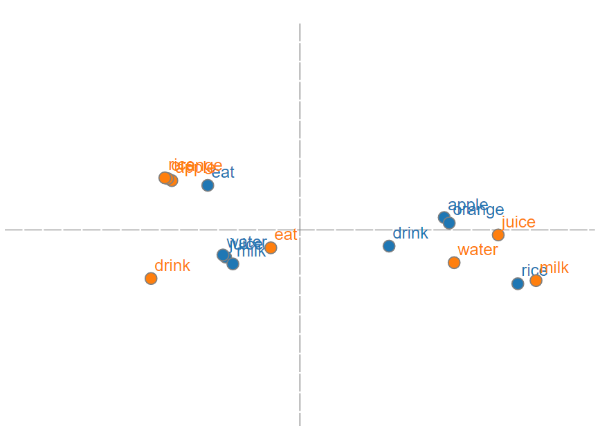
neural network and word vectors

Slide 25
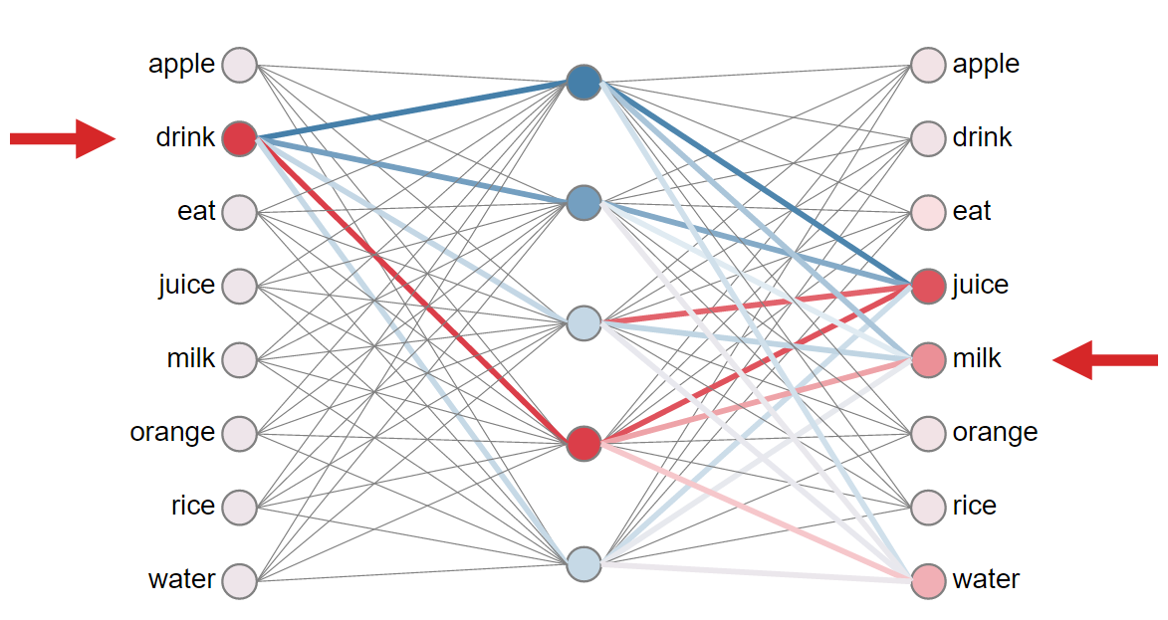
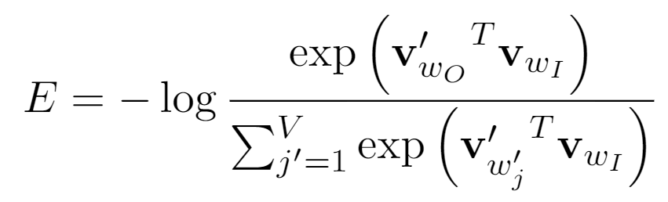
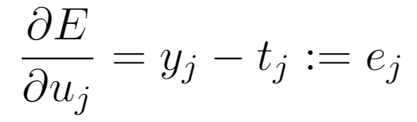
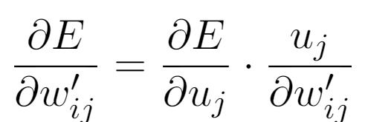
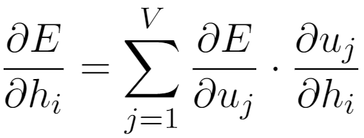
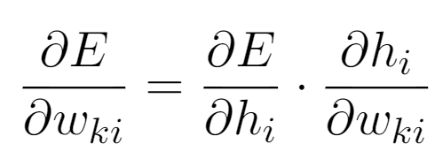
Training: updating word vectors

Slide 26
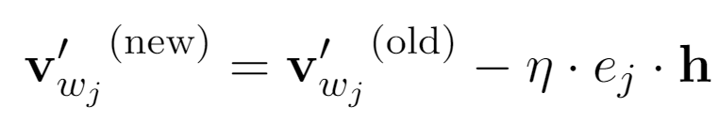

Intuition of output vector update rule

Slide 27


Intuitive Understanding of Input Vectors

Slide 28

Resemblance to a force-directed graph
equilibrium length ~ - strength of co-occurrence
more on this later...

Slide 29
word2vec decomposed
Input Corpus
Vocabulary
Builder
Lossy Counting
Vocabulary
Sentence Windows
Context Builder
Dynamic Window Scaling
Subsampling
Pruning
CBOW
Skip-gram
Input
Words
Output
Words
Vectors
(Final Product)
Parameter Learner
Backpropagation
Hierarchical Softmax
Negative Sampling

Slide 30
How do we select input and output words?
Method 1: continuous bag-of-word (CBOW)
eat an apple every day
Method 2: skip-gram (SG)
eat an apple every day

Slide 31
wevi
demo
(CBOW and SG)

Slide 32
word2vec decomposed
Input Corpus
Vocabulary
Builder
Lossy Counting
Vocabulary
Sentence Windows
Context Builder
Dynamic Window Scaling
Subsampling
Pruning
CBOW
Skip-gram
Input
Words
Output
Words
Vectors
(Final Product)
Parameter Learner
Backpropagation
Hierarchical Softmax
Negative Sampling

Slide 33
Training Generic Softmax is Intractable
need to update every single output vector!

Slide 34

Hierarchical Softmax

Slide 35
Negative Sampling

Slide 36
word2vec decomposed
Input Corpus
Vocabulary
Builder
Lossy Counting
Vocabulary
Sentence Windows
Context Builder
Dynamic Window Scaling
Subsampling
Pruning
CBOW
Skip-gram
Input
Words
Output
Words
Vectors
(Final Product)
Parameter Learner
Backpropagation
Hierarchical Softmax
Negative Sampling

Slide 37





Interpreting word embedding model
Coocurrence Matrix

Slide 38

Levy & Goldberg. "Neural word embedding as implicit matrix factorization." NIPS 2014.

Slide 39

Levy, Goldberg, and Dagan. ACL (2015)

Slide 40
Other neural embedding models
Bengio (2003)
Mnih & Hinton (2008)
Collobert & Weston (2008)
Minh et a. (2013)
GloVe by Pennington et al. (2014)
DeepWalk by Perozzi (2014)
LINE by Tang et al. (2015)

Slide 41


More on Word Analogy
Rohde, Gonnerman & Plaut (2005) "An Improved Model of Semantic Similarity Based on Lexical Co-Occurrence"

Slide 42
wevi
demo
(word analogy)

Slide 43
"Miscellaneous" Embedding
Word -> Word
Alternative input/output setting:
User -> Tweet
Customer -> Product
Word -> Parse-tree Neighbors
Entity -> Neighbor in a list
Node -> Random walk path in a graph
Notes:
Commonality: cooccurrence and higher-order cooccurrence. Matrix factorization.

Slide 44
Limitations
Word ambiguity
Debuggability
Sequence
Notes:
Current model taking advantage;
word2vec train-split-train style
Existing work addressing this issue:
Huang, Socher, Manning & Ng, 2012;
Trask, Gilmore, Russel, 2015

Slide 45
Take-aways
Word embedding techniques perform either explicit or implicit matrix factorization to word co-occurrence matrix.
The neural network structure of word2vec is a feedforward network with one hidden layer with a linear activation function.
The training method of word2vec is backpropagation with stochastic gradient descent.
The loss function is cross entropy.
Training can be made feasible by using either hierarchical softmax or negative sampling.
Word embeddings of equal quality as word2vec can be obtained via count-based methods with carefully tuned co-occurrence metrics.

Slide 46
Thanks!
Source code: github.com/ronxin/wevi
Online demo: ronxin.github.io/wevi

